Slide 1
STP

Slide 2
Segmentation Targeting Positioning

Slide 3
Dividing Heterogeneous market into homogenous market

Slide 4
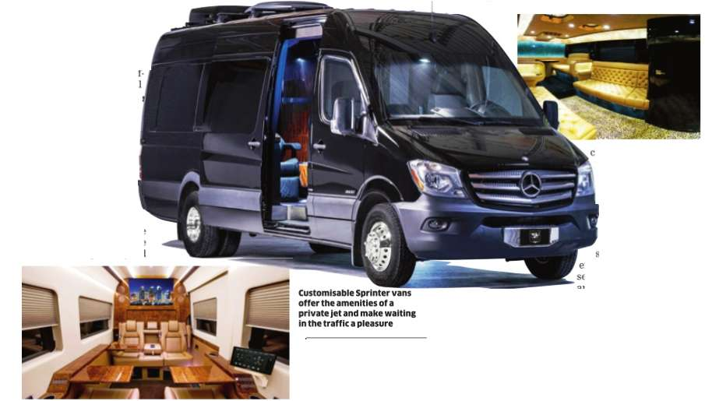
Segment: A group of customer having similar needs and wants
Nano Hatchback/Budget Cross Sedan SUV Traveller Sprinter Van Bus Luxury car

Slide 5
Company Cant serve all the customers- Resources Customer Diverse needs So look for specific segment and serve effectively SHOTGUN-Rifle

Slide 6
Mass market Mass Potential One size fits all approach Thali – Multicusine Focus or Scattered Complexities Mass------------Segment------------Individual LEGO Mass customization is the ability to prepare individually designed products and communications on a mass basis to meet each customer’s requirements. Mattel’s Barbie.com site invites girls to log on and design their own Barbie doll by specifying skin tone, eye color, hair color, clothes, accessories, and name.

Slide 7


Slide 8
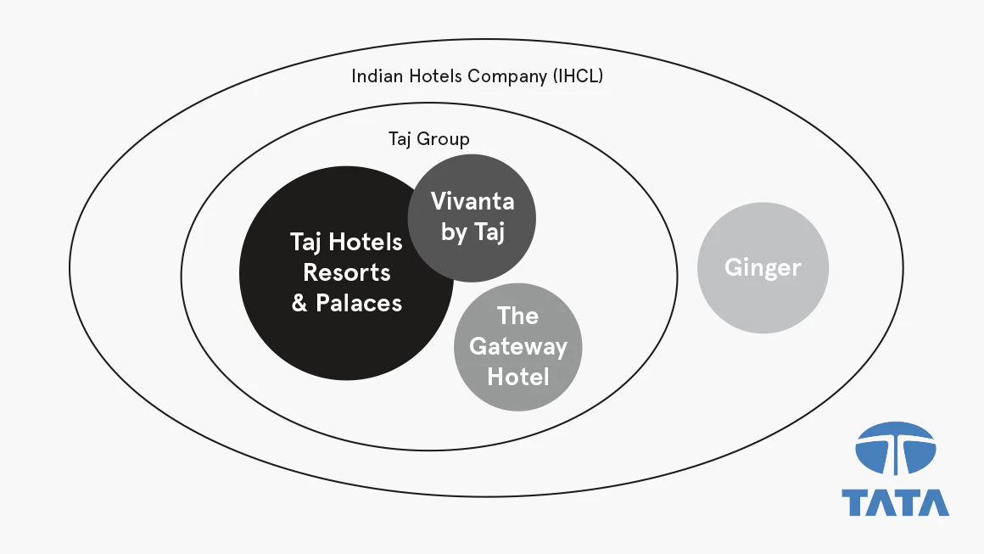

Slide 9

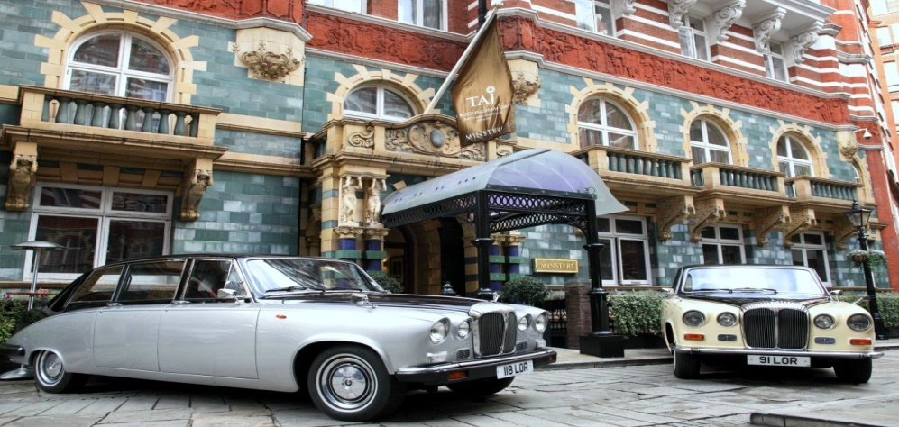
Taj
Taj’s brand architecture - a sun-and-planets model
At the center, the “sun” Taj, a top-tier luxury brand.

Slide 10
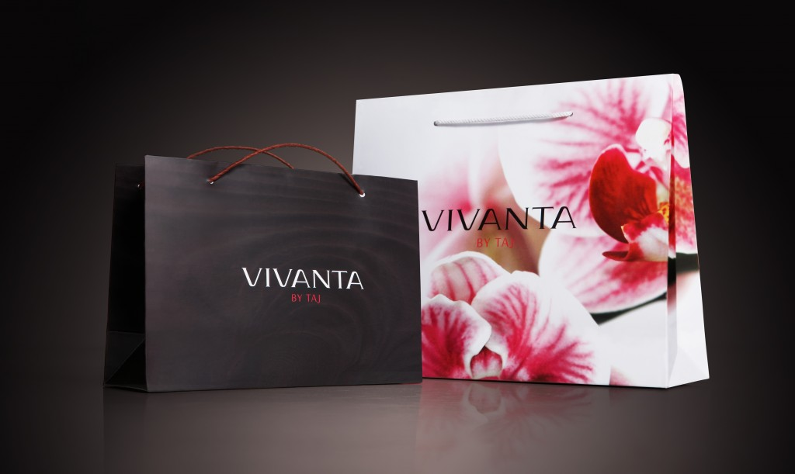
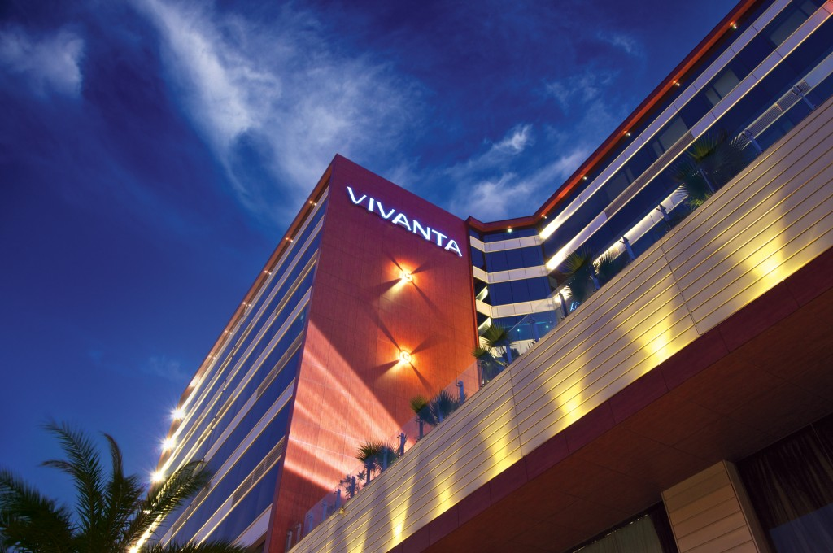
Vivanta by Taj for the upper upscale guest -one a full-service, Taj-endorsed brand
Vivanta by Taj was designed to capture an emerging high-end segment.
This younger, more cosmopolitan group of travelers wanted something new, contemporary, and technologically savvy.

Slide 11
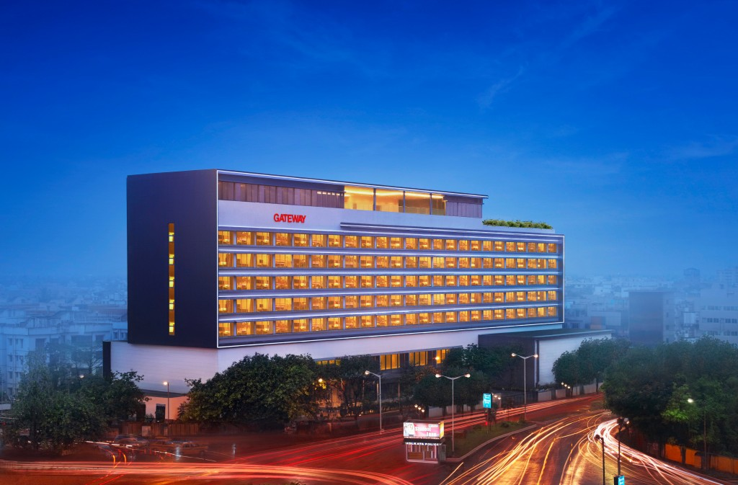
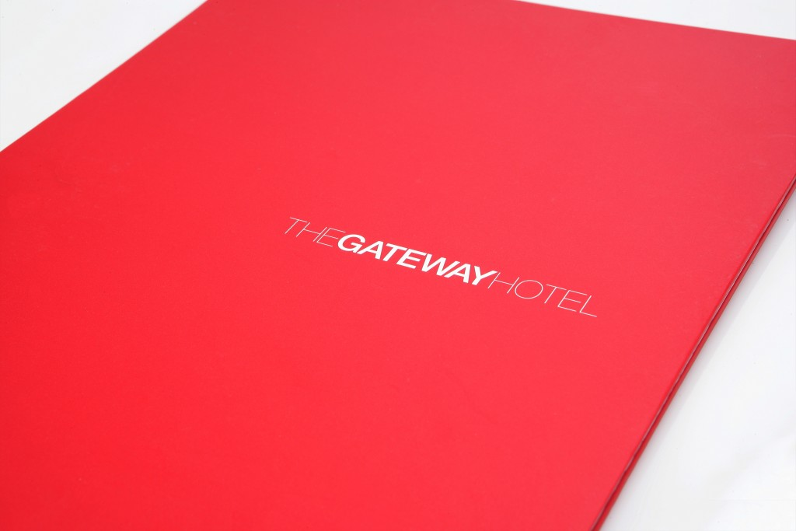
The other a mid-market business travel brand
(The Gateway Hotel).
India’s booming market had given rise to a large number of domestic business travelers.
Taj Group created the Gateway Hotel, a three-star national brand, to cater to this segment and fill the gap in its portfolio.
Although it falls under the corporate umbrella, The Gateway is not endorsed by Taj, keeping its identity separate from the Taj’s luxury positioning.

Slide 12
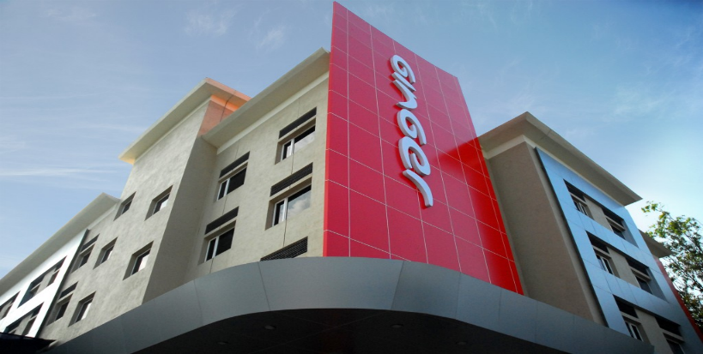
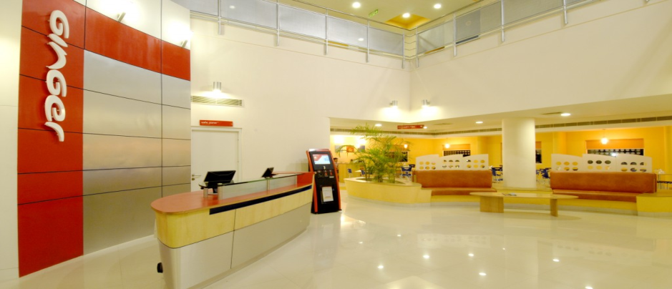
Ginger for the budget traveler
Ginger, a two-star economy brand, focuses on secondary and tertiary cities in India, where the hospitality sector - disorganized and unpredictable.
To avoid having Taj associated with a budget chain, Ginger functions as a separate subsidiary outside the purview of the Taj Group.
Its name and visual identity evoke a simple, practical hotel experience

Slide 13
Taj’s brand architecture - a sun-and-planets model
At the center, the “sun” Taj, a top-tier luxury brand.
A full-service, Taj-endorsed upscale brand (Vivanta by Taj)
The other a mid-market business travel brand (The Gateway Hotel).
A third new brand, Ginger, would offer two-star economy stays as a separate subsidiary not connected with the Taj name.

Slide 14
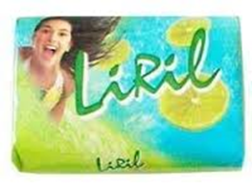

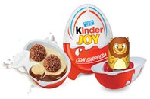


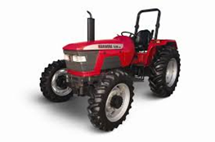


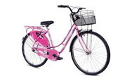
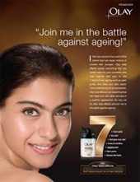
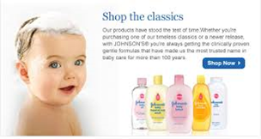

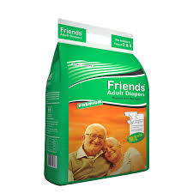
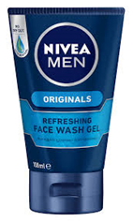

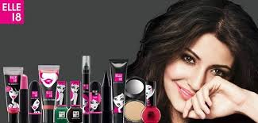
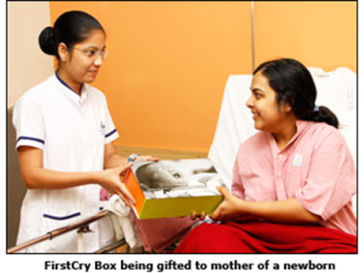
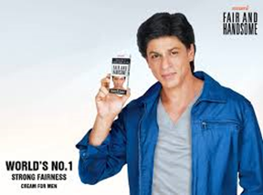



Slide 15
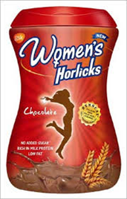
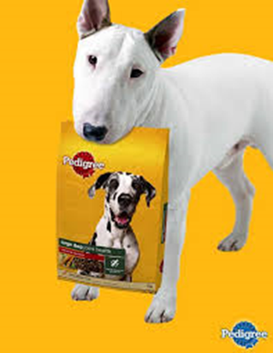

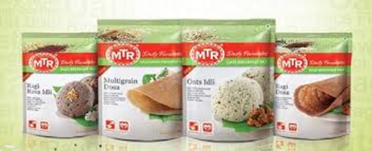
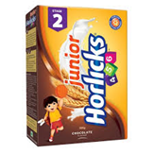



Slide 16


Slide 17
Patterns Market Segmentation- Market segments can be built up in many ways- One common method is to identify preference segments. Suppose ice cream buyers are asked how much they value sweetness and creaminess as two product attributes Homogenous Diffused Clustered
s
c
Shows a market in which all of the consumers have roughly the same preference, so there are no natural segments.
At the other extreme, consumer preferences may be scattered throughout the space, indicating great variance in consumer preferences.
The market might reveal distinct preference clusters, called natural market segments.

Slide 18
Bases For Segmenting Consumer Markets Geographic- Urban, Rural, Region Demographic- Age group, Gender, Income Psychographic- Lifestyle, Personality Behavioral-Occasions, Usage rates, User Type etc.

Slide 19

ITC Foods is making a strategic shift by launching a new range of health-oriented products specifically designed for consumers aged 45 and above. ITC is now introducing a line that includes upma, oats, cookies, and enriched atta under the “Right Shift” brand, aiming to cater to the dietary needs of an often-overlooked age group. This move targets a significant market segment, with nearly 10 million households falling within this demographic. “By 2050, 40% of India’s population will be over 45, and this group is increasingly looking to make healthier food choices as they age” “This demographic has a strong propensity to spend, with food making up a substantial part of their discretionary spending- stay healthy and active.” By targeting the 45+ age group, ITC Foods is addressing a market gap and aligning with broader industry trends of health consciousness and premium product offerings.

Slide 20
TARGETING Decide how many and which segments it can serve best Mass Undifferentiated Segment Differentiated Concentrated Niche

Slide 21
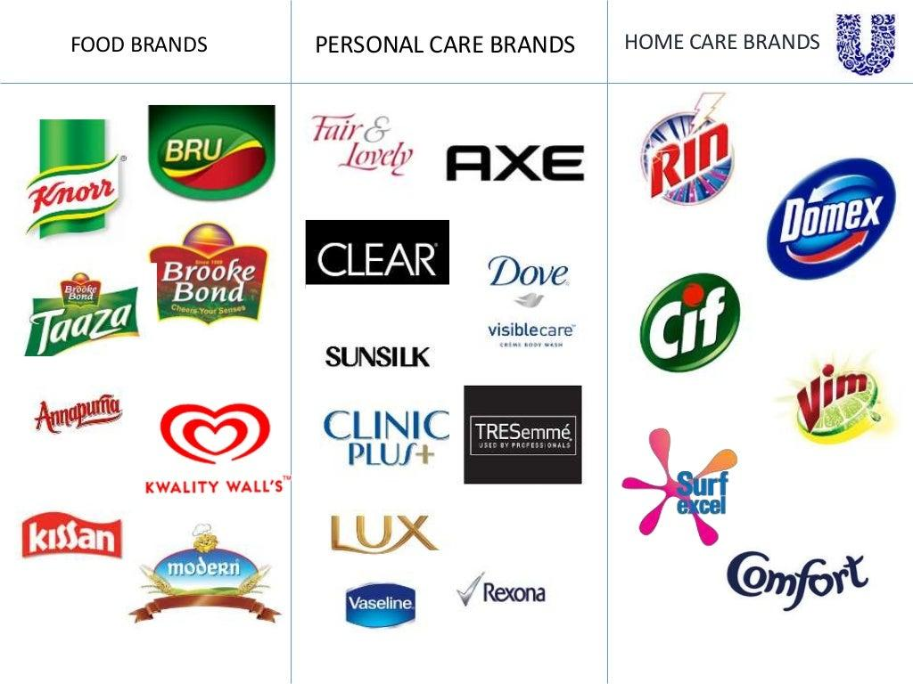

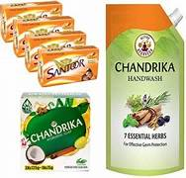
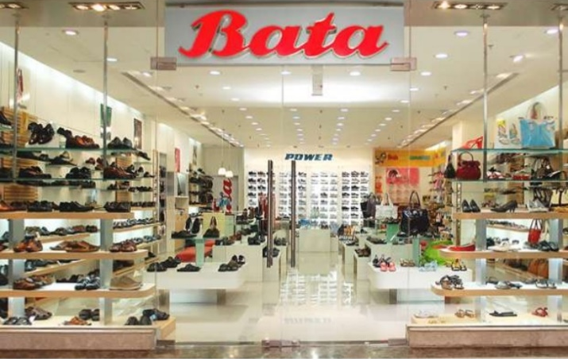

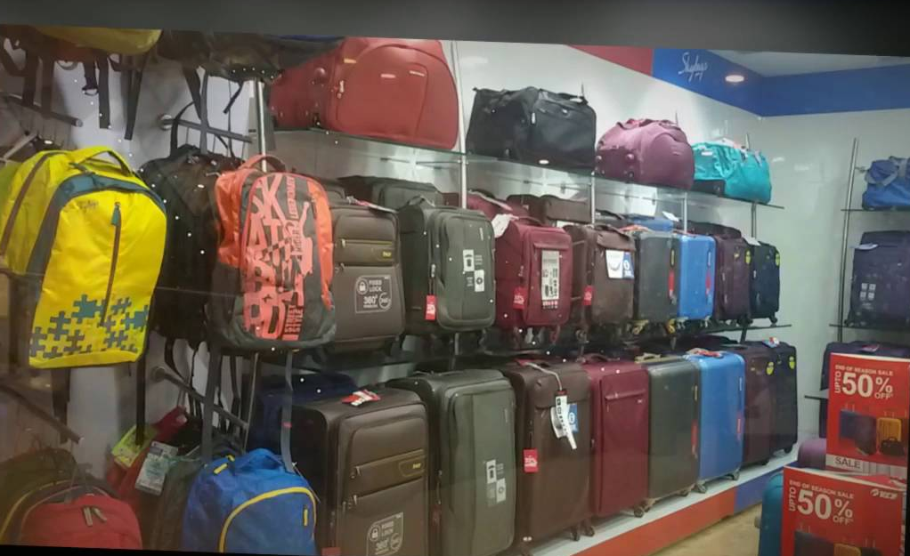
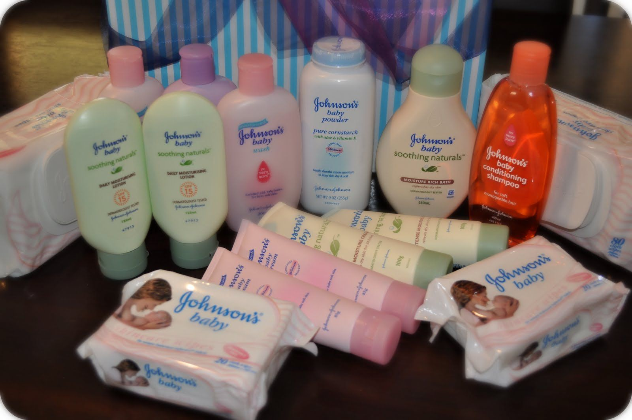


Slide 22
Market Specialization
Five patterns of target market selection
Product Specialization
M1
P1
Full Market Coverage
Single Segment Concentration
Selective Specialization

Slide 23
Target market selection (Attractiveness of Segment and Objectives and Resources) Having evaluated different segments, company can consider five patterns of target market selection. Single-Segment Concentration-Many companies concentrate on a single segment, Through concentrated marketing, the firm gains a thorough understanding of the segment’s needs and achieves a strong market presence. Selective Specialization -Many companies prefer to operate in more than one segment. Selective Specialization Here the firm selects a number of segments, each objectively attractive and appropriate. There may be little or no synergy among the segments. This multisegment coverage strategy has the advantage of diversifying the firm’s risk. Product Specialization- Another approach is to specialize in making a certain product for several segments. Through a product specialization strategy, the firm builds a strong reputation in the specific product area. Market Specialization -With market specialization, the firm concentrates on serving many needs of a particular customer group. The firm gains a strong reputation in serving this customer group and becomes a channel for further products that the customer group could use. Full Market Coverage -Here a firm attempts to serve all customer groups with all of the products they might need. Only very large firms can undertake a full market coverage strategy.

Slide 24
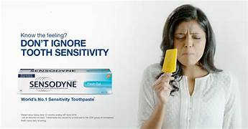
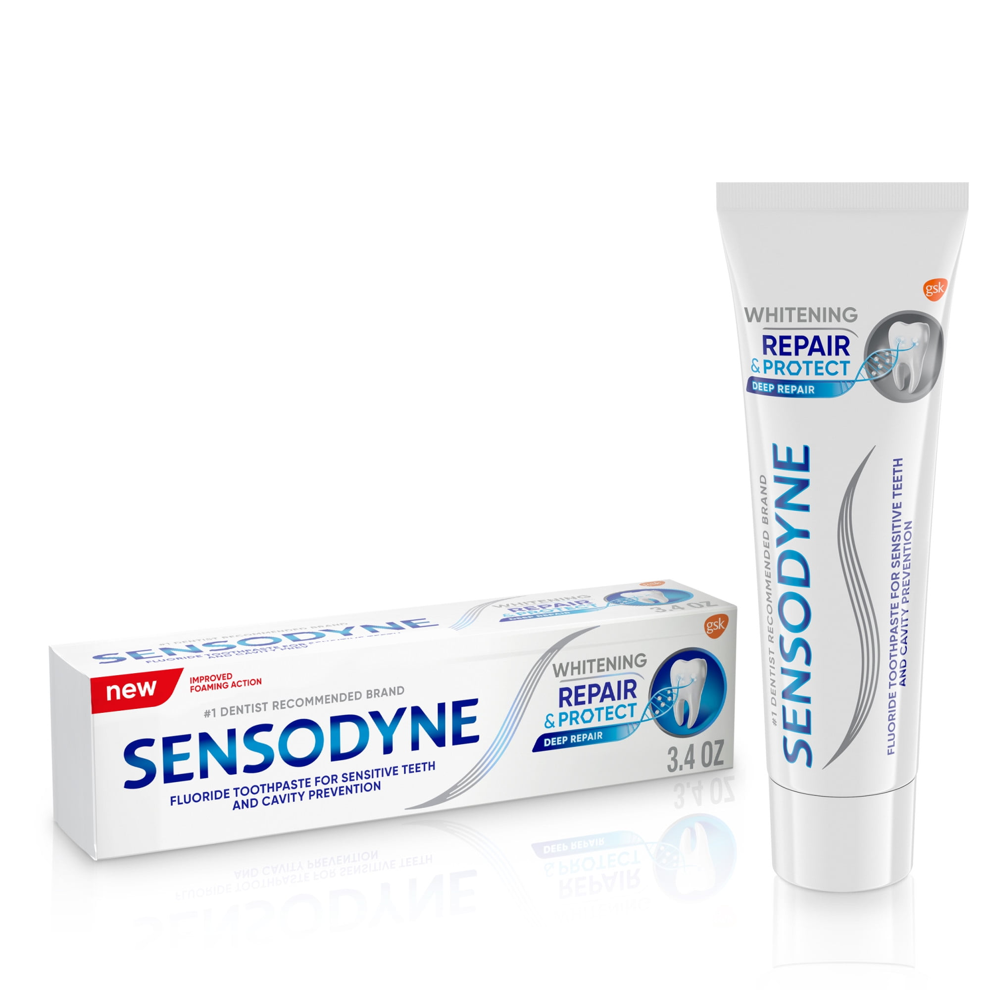

Slide 25
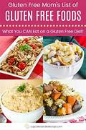
Large market
Niche

Slide 26
Market Segmentation- Divide Target Marketing- Select Positioning-Mind Differentiation- Differentiate

Slide 27
Brand Positioning

Slide 28

Brand Positioning
Early 80’s –Prior Image-Al Ries and Jack Trout
Unique, clear and desirable slot that brand occupies in the mind of consumers, relative to competing brands
Positioning is the act of designing the company’s offering and image to occupy a distinctive place in the mind of target market.
Costliest real estate, plot yours, slot in mind, no one can take it

Slide 29
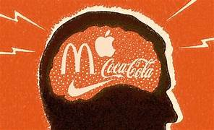

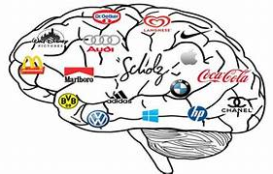

Slide 30
Positioning is not what you do to the product.
Positioning is what you do to the mind of prospect.

Slide 31
Brand Position
Brand position is the part of the brand identity and value proposition that is to be actively communicated to the target audience and that demonstrates an advantage over competing brands.
McDonalds cleanliness is certainly one of the important parts of the culture and identity. It would be unlikely to be a part of the brand position, however, because it would not differentiate McDonalds from its major competitors.

Slide 32
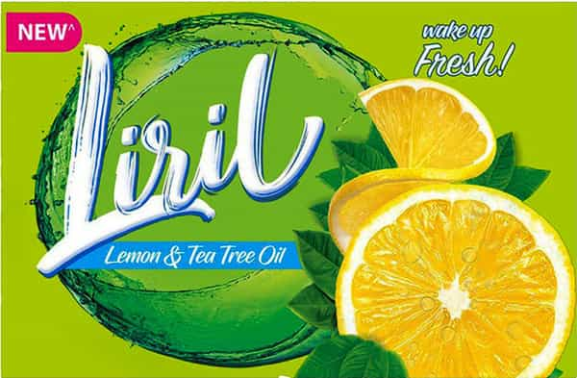
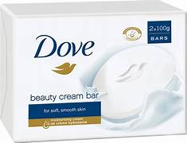
Liril WHAT- Key Benefit- Freshness WHOM- Target Group- Young Active life WHY- Reason To believe- Lime Dove WHAT WHOM WHY

Slide 33
Moist skin- Dry skin problem- 1/4th moisturizer

Slide 34
Who am i? Why buy me?
Who am i? ANSWER- SOAP
Why buy me? ANSWER- I clean
NO -Then no spot occupied
What role my brand play in the life of customers?
What do I do that others don’t?
Why should you believe my brand?
DOVE-
Role –Empowerment, Self esteem booster
Why buy/ others don’t-/ Unique- I make soft skin and don’t make skin dry
Believe- Because it has 1/4th moisturizer

Slide 35
What comes to your mind- one word
Volvo, Chings, Rayban, Raymonds, Kitkat
Sharply positioned brand
A single word encapsulates the essence of the brand
Consumer cant remember everything
One word- Essay
What lies at the heart of the brand
Harley Davidson

Slide 36
Harley Davidson
Different answers/Why so?
Some brands- single word- ideal positioning
Other brands- 3 to 4 words to describe
Adventure/Freedom/Lifestyle
Snickers- Hungry Kya?

Slide 37
Can you explain your brand in 7 seconds
Apple
Dove
Starbucks
Simplicity
Real beauty
Moments

Slide 38
Can the same brand have different positioning in different markets
MTR-
South - Convenience, avoid labor, Time saved, all process gone, have knowledge want to save time, everyday same process boredom, Instant North - Confidence- what's this- Family reaction,

Slide 39
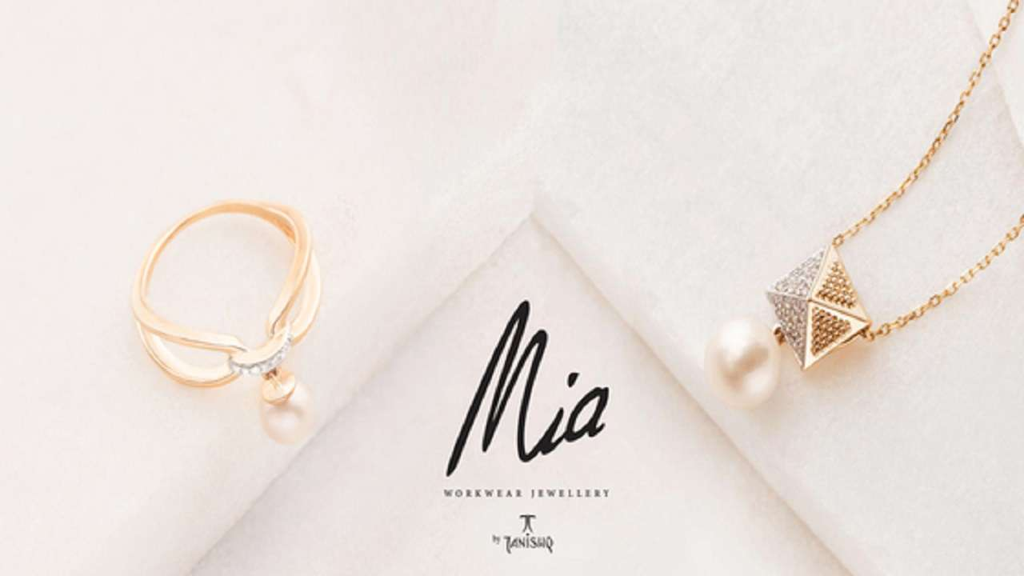

Slide 40
Perceptual Mapping or Positioning Map
Graphical representation on how customers see different brands in the category
Which slot is occupied by brand
Capturing it on paper is perceptual map
Capture dimension then map
Factor analysis- factors that customer considers
Rate

Slide 41
Medicinal
High Efficiency
Low efficiency
Natural

Slide 42
Perceptual Mapping or Positioning Map
Pfizer
Abbott
Gsk
Medicinal
Gelusil
Digene
ENO
High Efficiency
Low efficiency
Pudin Hara
Natural

Slide 43
Use - Analysis
Whether intended position achieved or GAP
Opportunities for repositioning

Slide 44
Perceptual Mapping or Positioning Map
Medicinal
Gelusil
Digene
ENO
High Efficiency
Low efficiency
GAP
Pudin Hara
Natural

Slide 45
POP and POD

Slide 46
Benefit Map: Vs Competitor, Vs Benefits DOVE CAMAY
Functional
How does it differ functionally Both different
What is the similarity functionally Both same
1/4th Moisturizer
Does not dry skin
Beauty Bar Cleansing Lather
Premium Price
Range of variants
POP
Non discriminating
POD
Discriminating
Genuine
Enhances Self esteem
Empower woman
Reputed Maker
Bathing Experience
Trusted Brand
How does it differ non- functionally Both different
What is the similarity non-functionally
Both same
Non Functional

Slide 47
Significance 1 POP’S – why are they needed? Why are they important? must have- basic hygiene factor customers want it cant drop camera from smartphone is the brand satisfying customer need? Are pop’s delivering must haves of category
2 POD’s – Does brand have strong and sufficient Pod’s? thinly populated Are there strong pod’s to create differences? Dove fragrance- h2s?
3 is there an opportunity to convert pop’s into pod’s Beauty bar-bathing gel-shower gel-liquid soap

Slide 48
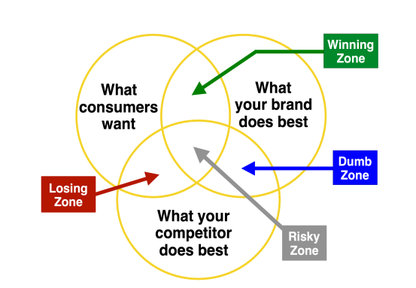

Slide 49
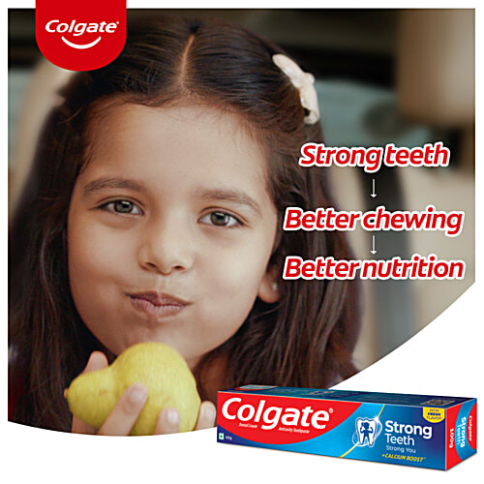

Slide 50
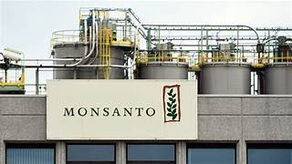




Slide 51
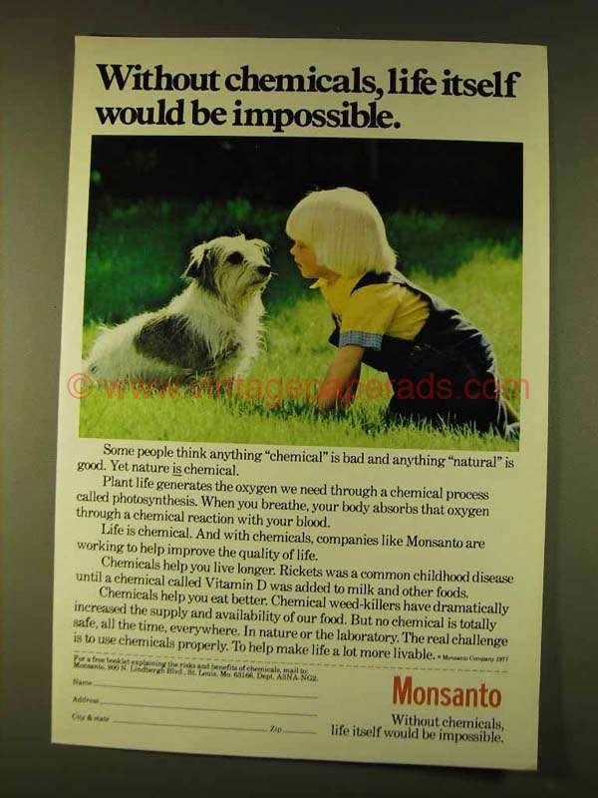
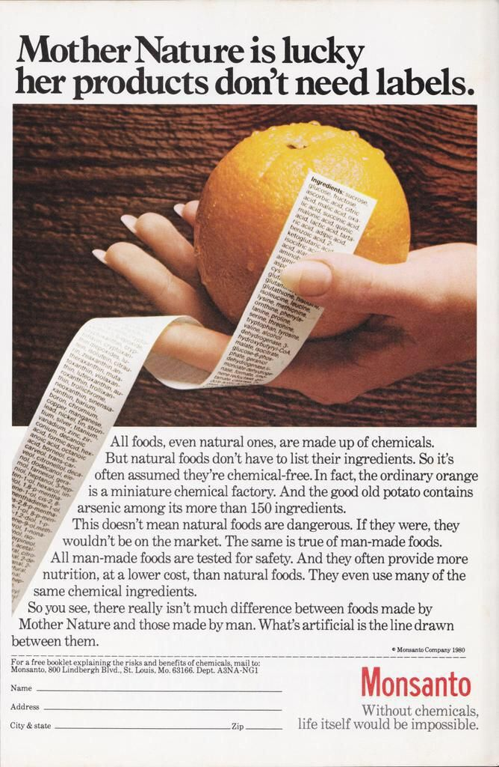

Slide 52
Positioning Statement

Slide 53


Slide 54
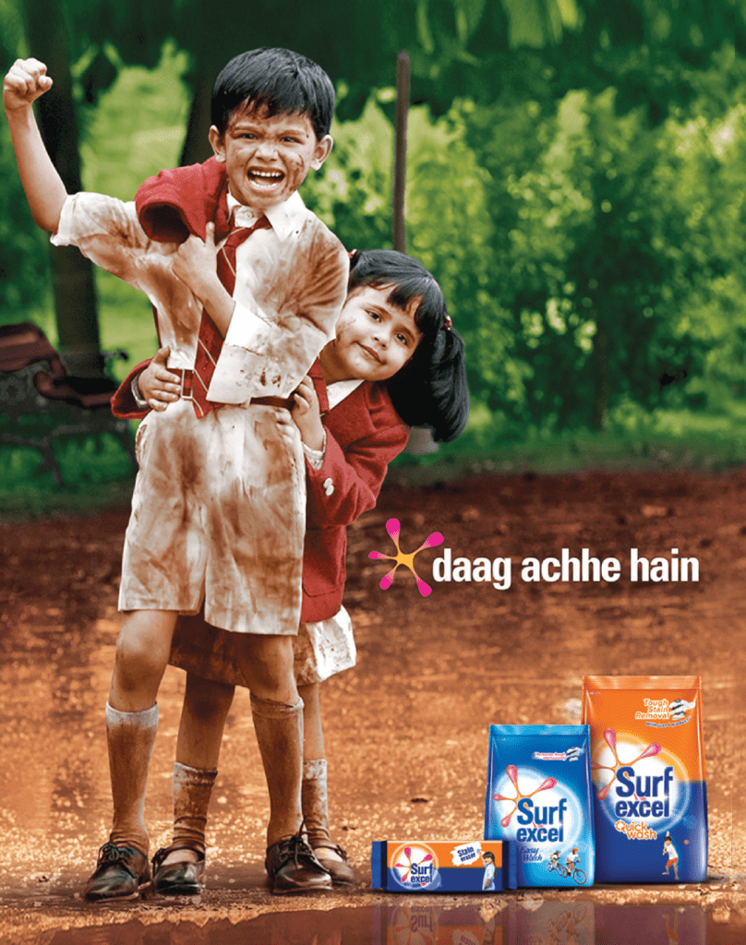

Slide 55


Slide 56


Slide 57
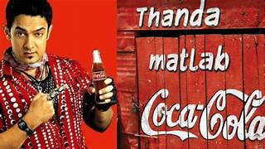

Slide 58


Slide 59


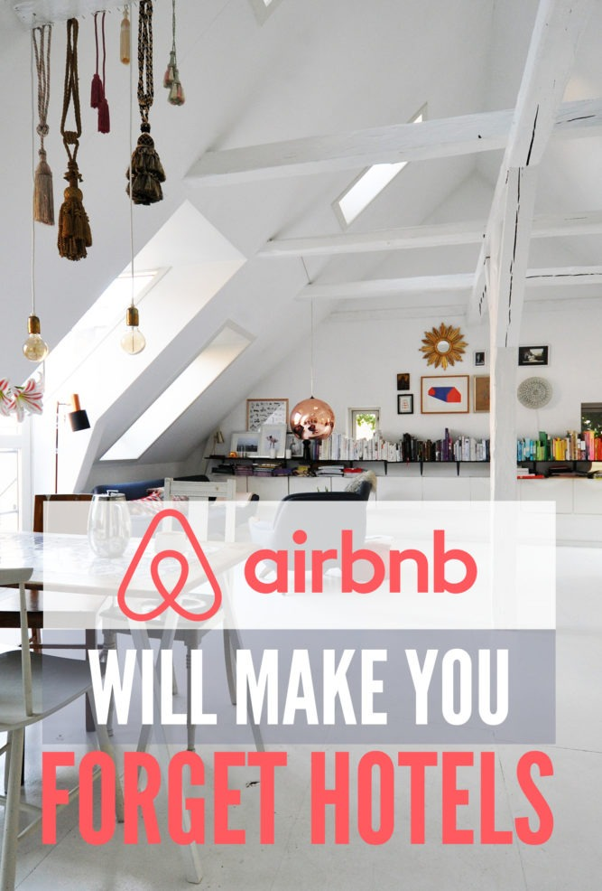



Slide 60


Slide 61
Thank You

